Slide 1
Valuing a Forward Contract
A forward contract is worth zero (except for bid-offer spread effects) when it is first negotiated
Later it may have a positive or negative value
Suppose that K is the delivery price and F₀ is the forward price for a contract that would be negotiated today

Slide 2
Valuing a Forward Contract (equation 5.4)
By considering the difference between a contract with delivery price K and a contract with delivery price F₀ we can deduce that:
the value of a long forward contract is (F₀ – K )e^{–rT}
the value of a short forward contract is
(K – F₀ )e^{–rT}

Slide 3
Chapter 3 Hedging Strategies Using Futures

Slide 4
Long & Short Hedges
A long futures hedge is appropriate when you know you will purchase an asset in the future and want to lock in the price
A short futures hedge is appropriate when you know you will sell an asset in the future and want to lock in the price

Slide 5
Arguments in Favor of Hedging
Companies should focus on the main business they are in and take steps to minimize risks arising from interest rates, exchange rates, and other market variables

Slide 6
Arguments against Hedging
Shareholders are usually well diversified and can make their own hedging decisions
It may increase risk to hedge when competitors do not
Explaining a situation where there is a loss on the hedge and a gain on the underlying can be difficult

Slide 7
Basis Risk
Basis is usually defined as the spot price minus the futures price
Basis risk arises because of the uncertainty about the basis when the hedge is closed out

Slide 8
Long Hedge for Purchase of an Asset
Define
F₁ : Futures price at time hedge is set up
F₂ : Futures price at time asset is purchased
S₂ : Asset price at time of purchase
b₂ : Basis at time of purchase
Cost of asset | S₂
Gain on Futures | F₂ −F₁
Net amount paid | S₂ − (F₂ −F₁) =F₁ + b₂

Slide 9
Short Hedge for Sale of an Asset
Define
F₁ : Futures price at time hedge is set up
F₂ : Futures price at time asset is sold
S₂ : Asset price at time of sale
b₂ : Basis at time of sale
Price of asset | S₂
Gain on Futures | F₁ −F₂
Net amount received | S₂ + (F₁ −F₂) =F₁ + b₂

Slide 10
Choice of Contract
Choose a delivery month that is as close as possible to, but later than, the end of the life of the hedge
When there is no futures contract on the asset being hedged, choose the contract whose futures price is most highly correlated with the asset price. This is known as cross hedging.

Slide 11
Optimal Hedge Ratio (equation 3.1)
Ignoring daily settlement of futures (or assuming forwards are used) , the proportion of the exposure that should optimally be hedged is
where
σ_{S} is the standard deviation of ΔS, the change in the spot price during the hedging period,
σ_{F} is the standard deviation of ΔF, the change in the futures price during the hedging period
ρ is the coefficient of correlation between ΔS and ΔF.

Slide 12
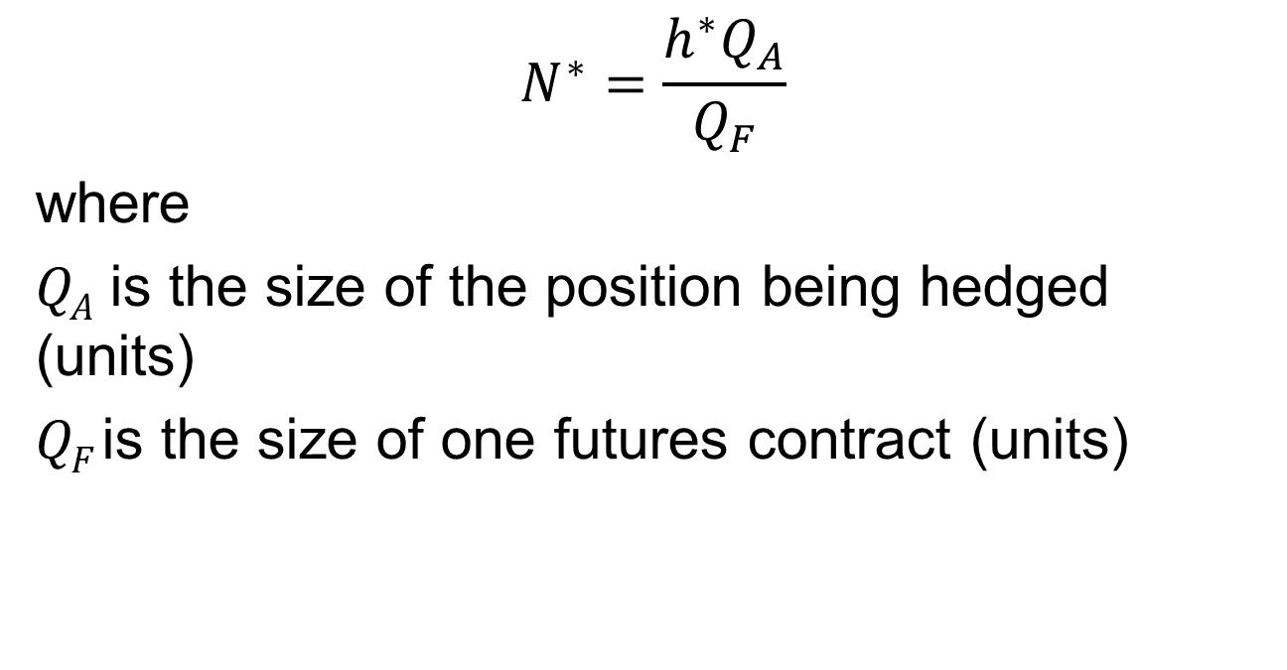
Optimal Number of Contracts (equation 3.2)
$$N^{∗}=\frac{h^{∗}Q_{A}}{Q_{F}}$$
where
Q_{A} is the size of the position being hedged (units)
Q_{F} is the size of one futures contract (units)

Slide 13
Example (Example 3.3)
Airline will purchase 2 million gallons of jet fuel in one month and hedges using heating oil futures
From historical data σ_{F} =0.0313, σ_{S} =0.0263, and ρ= 0.928

Slide 14
Example continued
The size of one heating oil contract is 42,000 gallons
Optimal number of contracts is
which rounds to 37

Slide 15

Optimal Number of Contracts When Contract Is Settled Daily
$$N^{∗}=\hat{ρ }\frac{{\hat{σ}}_{S}SQ_{A}}{{\hat{σ}}_{F}FQ_{F}}$$
where variables are defined as follows
 | Correlation between percentage daily changes for spot and futures
 | SD of percentage daily changes in spot
 | SD of percentage daily changes in futures

Slide 16
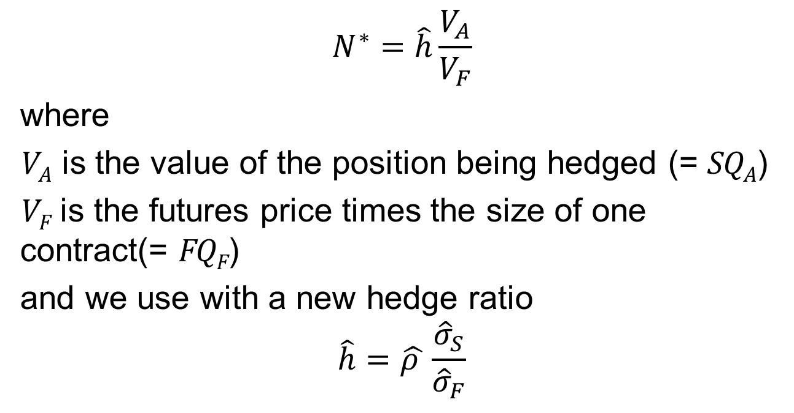
An Alternative Expression for N* when there is daily settlement (equation 3.3)
$$N^{∗}=\hat{h}\frac{V_{A}}{V_{F}}$$
where
V_{A} is the value of the position being hedged (= SQ_{A})
V_{F} is the futures price times the size of one contract(= FQ_{F})
and we use with a new hedge ratio
$$\hat{h}=\hat{ρ }\frac{{\hat{σ}}_{S}}{{\hat{σ}}_{F}}$$

Slide 17
Daily Settlement
Day to day changes in N* are small and often ignored
Tailing the hedge involves dividing N* by one plus the amount of interest that will be earned over the remaining life of the hedge

